Slide 1
Stage 18: Internet

Slide 2
Objectives
Students will:
Learn about the complexity of sending messages over the Internet
Translate URLs into IP Addresses
Practice creative problem solving

Slide 3
Vocabulary
IP Address - A number assigned to any item that is connected to the Internet
DNS (Domain Name Service) - The service that translates URLs to IP addresses
URL (Universal Resource Locator) - An easy-to-remember address for calling a web page (like www.code.org)
Internet - A group of computers and servers that are connected to each other
Servers - Computers that exist only to provide things to others
Fiber Optic Cable - A connection that uses light to transmit information
Wi-Fi -A wireless method of sending information using radio waves
DSL/Cable -A method of sending information using telephone or television cables
Packets - Small chunks of information that have been carefully formed from larger chunks of information

Slide 4
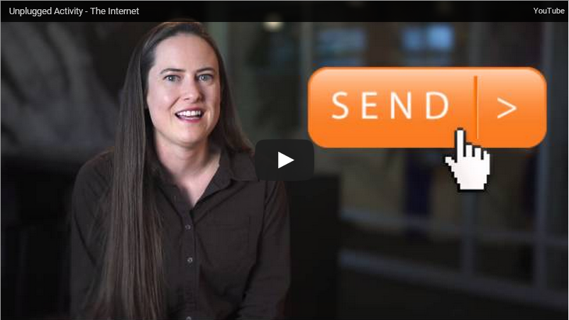
Video
https://studio.code.org/s/course3/stage/18/puzzle/1

Slide 5
Example

Slide 6
Directions
Complete the Stage 18: Internet
Progress your way through the stage

